Slide 1


NOVEL ENERGY CURED MERCAPTO FUNCTIONAL SILICON Q RESIN MATERIALS FOR COATINGS
Tom-Seung Cheung
John Grande
Yanjun Luo
Bob Ruckle
Steve Wilkowski
Siltech Corporation
Toronto, ON Canada
Steve.Wilkowski@siltech.com
Robert@siltech.com
Tom@siltech.com

Slide 2

The Challenge:
Elongation in UV cured silicone systems
Silicones routinely provide up to 300% elongation in homopolymers or organic/ silicone hybrid copolymers
However, UV cured acrylate silicones do not do this as elongation is typically under 10%.
The mercapto/vinyl systems bring elongation back to >100%.

Slide 3
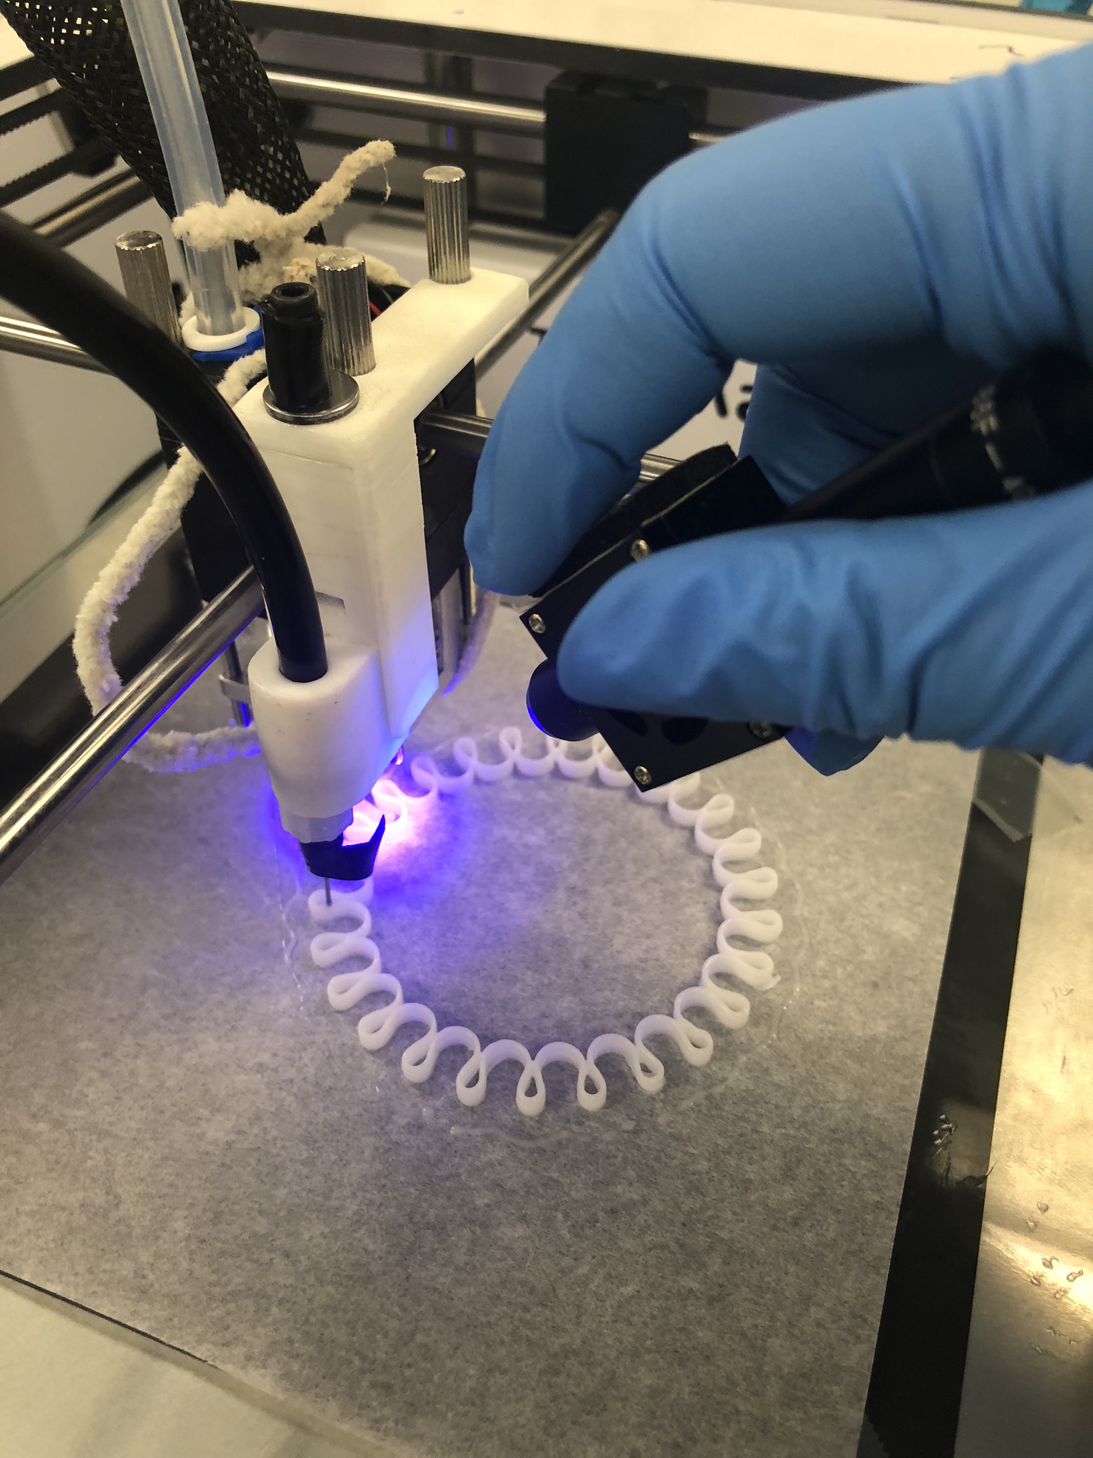
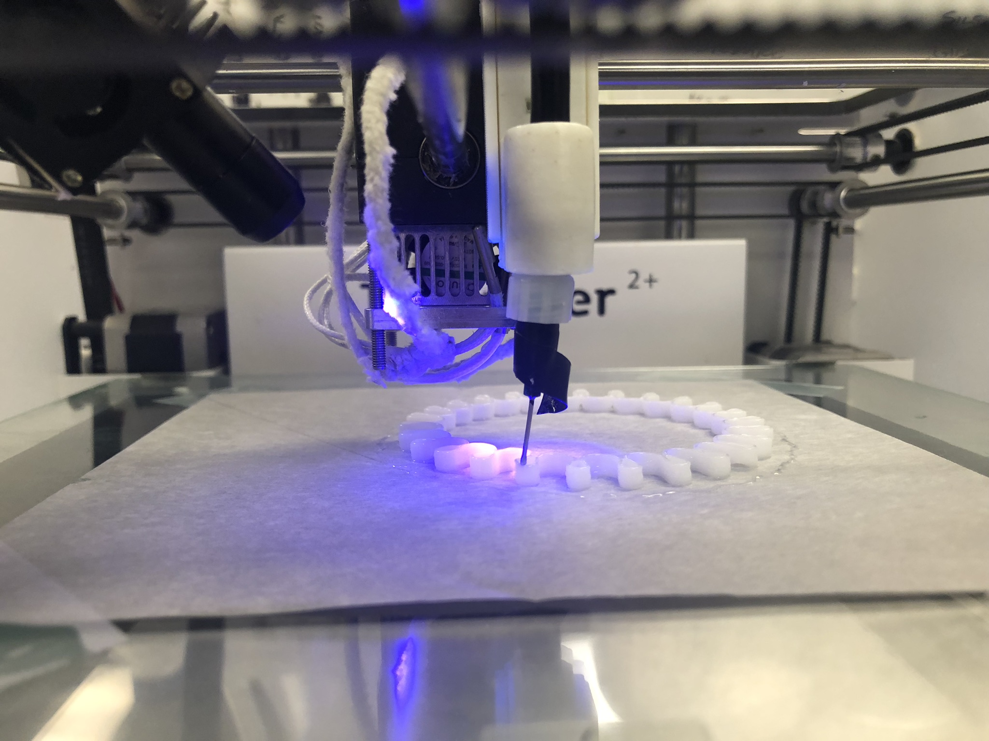
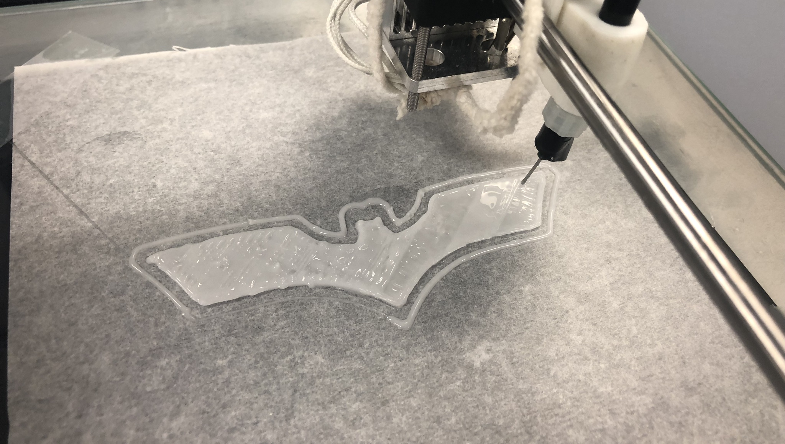
Need for FLEXIBLE UV 3D printing with silicone materials.
How would this apply to coating applications?

Slide 4
Polymers from
Condensation Reactions
n
R₂ = hydroxyalkyl
silicone
x
n
The flexible silicone is in the backbone, providing improved elongation.

Slide 5
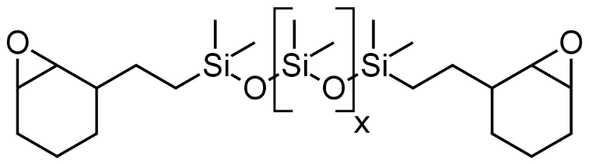
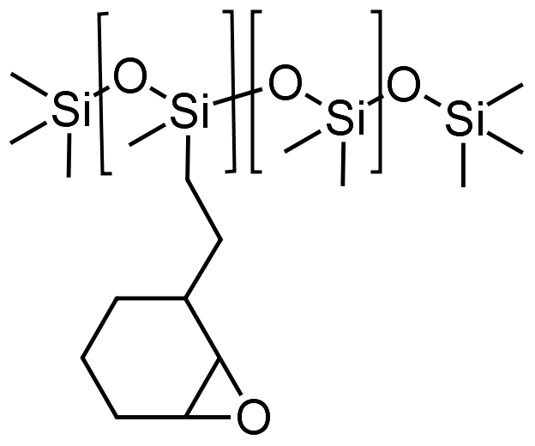
Epoxy Silicone System
Linears
X=400 (20-34%)
X=10 (10-35%)
5-11% MHHPA
AMI-1
110°C, 4 hours
8
250
X-linker (8%)
Notes:
G230-G235 is 2K Heat cure silicone epoxide blend without use of orange epoxy resin.
Project Report 1162 Part VIII

Slide 6
Free Radical Polymerization
R1=Me, PMA
x
x
R1=Mono Acrylate Silicone
n
The flexible silicone is NOT
in the backbone.

Slide 7
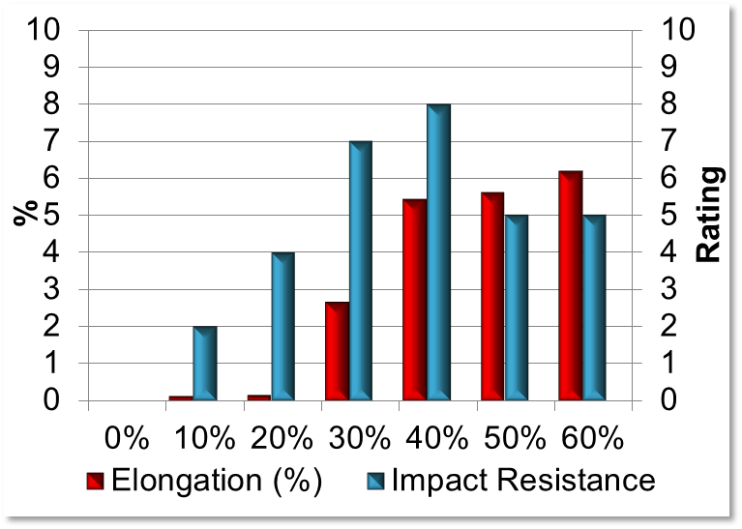
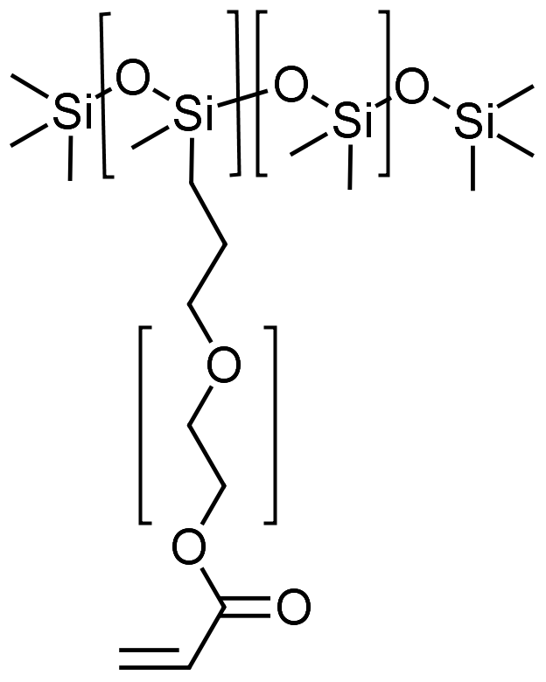
Acrylate Silicone UV coating
0-80% Silicone
0-80% Epoxy Acrylate
13% Synergist
5% curing aid
1.5% initiator
0.5% reactive defoamer
UV light, RT
4
8
8

Slide 8
Polymers from Thiol Ene Reaction
R1=organic
x
R1=Silicone
x
x
x
R1=Silicone
R2=MQT Resin
x
Places flexible silicone
into the backbone.
x

Slide 9
Basic Mercapto Formulations
Ingredient | Amount (wt %) | Purpose
Mercaptosilicon Resin | ~25% | Cross-linker
Vinyl Siloxane Fluid | ~60% | Extender
Vinyl Silicon Resin | ~10% | Softer Cross-Linker
Phosphine Oxide | 0.6-0.7% | Photoinitiator

Slide 10
Silicon Nomenclature
M group
T group
Trialkoxy silanes are T groups
D group
MD_{x}M is silicone oil
- PDMS
Q group

Slide 11
Systems used for coating testing
Categories | Sample Name | Description | Curing
Experimental Mercaptosilicone formulations | YL5-2A | Highest Q content | UV cure
 | YL5-2B | Lower Q with higher T | UV cure
 | YL5-3A | Highest T content | UV cure
Controls | YL5-3B | Silicone Acrylate System | UV cure
 | YL5-4B | VQT/HQ 2 part LSR | Heat cure
 | YL5-4C | VQ/SiH 2 part LSR with adhesion promoter | Heat cure

Slide 12
Experimental
Shore A Hardness
Shore A Hardness is measured by holding vertically with the point of the indenter at least 12mm from any edge of the specimen. Obtain the maximum reading from the durometer.
Tensile, Tear strength, Elongation
Cure sample in a 6x6 mold and cut it with ASTM D412 type C and ASTM D624 type C dies.
Impact Resistance
The impact tester is similar to ASTM D2794 – Universal Impact Test Method for Paints and coatings. The coating is applied to an aluminum panel

Slide 13
Experimental
Abrasion Resistance
Abrasion resistance is measured using Sutherland 2000 Ink Rub Tester - Dry Rub method. The rating is obtained by comparing surface defects of all panels visually against the control. 10 is the best and 0 is the worst.
Pencil Hardness
The pencil tester is used to test coatings for their hardness and resistance to scratches and wear. Pencils with known hardness grade is moved over the coated surface at 45 degree angle and a fixed pressure.

Slide 14
Experimental
Corrosion Resistance
Corrosion resistance refers to how well the coated bare steel Q panel can withstand damage caused by 5% salt water. The rating is obtained by visual inspection to the coatings. Adhesion to the substrate is also rated at the end of the corrosion test by visual inspection of the cross-cut surface.
Mandrel Bend
The bend test is performed by manually roll the coatings around a cylindrical rod (diameter 1.5 inch) and manually bending the coated Aluminum panels 180 degree. Coating damage including cracks, adhesion and colour change are recorded.

Slide 15

Experimental
Experiments were conducted in a TA Instruments Rheometer with a UV reactive chamber.
The rheological properties including G’, G’’, tan (δ) and cure rate are analyzed and obtained by the TA Rheology Advantage software.

Slide 16
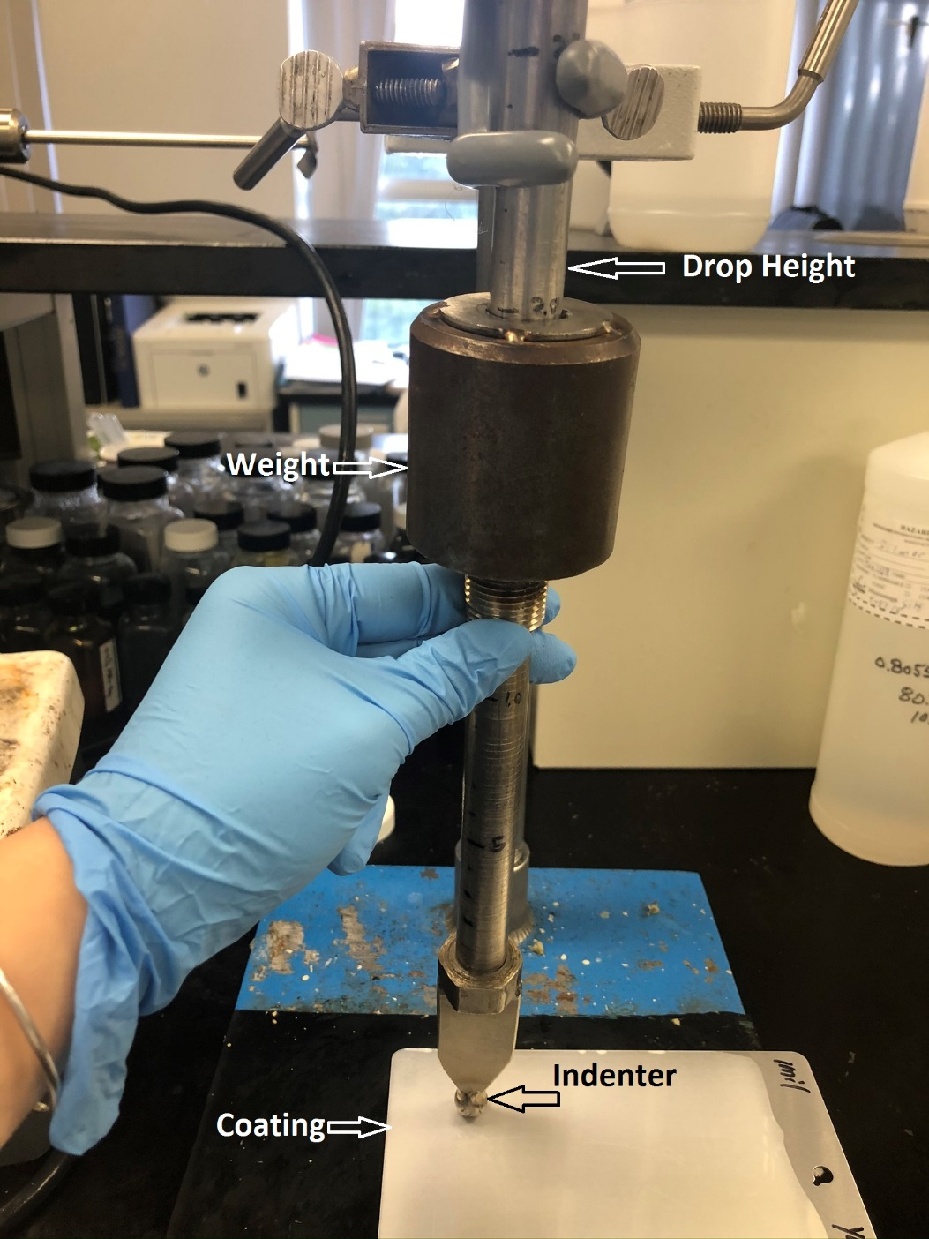
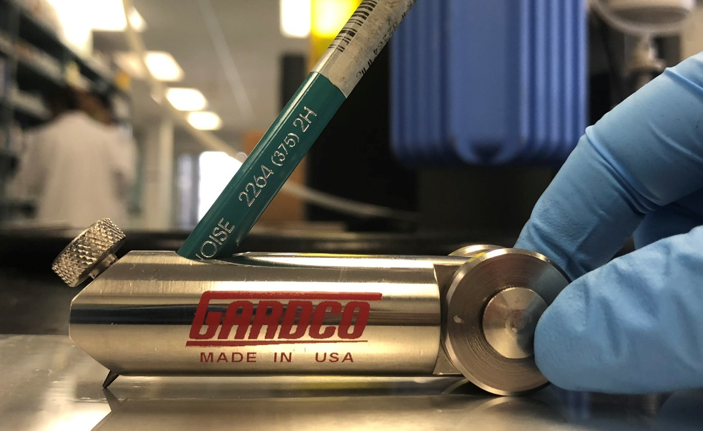
Impact test
Hardness test

Slide 17
Silicone Mercapto variants perform well vs. other systems

Slide 18
Silicone Mercapto variants provide good film properties.
Superior to the UV cured acrylate,
but inferior to heat cure in some tests.

Slide 19
Conclusions- balancing cross-link density to achieve performance.
MQT & VTQ resin balance optimized for best performance
SH/vinyl stoichiometry is important
T resin provides flexibility, but less toughness
Vinyl fluid provides elongation and tear strength, but a reduction of hardness and tensile

Slide 20
Conclusions – a flexible, UV cured organo-silicone coating system achieved.
Mercaptosilicone UV cure systems show better adhesion to substrates and similar or slightly inferior performance vs. the heat cured, vinyl/hydride Liquid Silicone Rubber system.
Mercaptosilicone UV cure systems demonstrate good mechanical and film properties, signficantly better than tested UV silicone acrylate systems.

Slide 21
Thank you!
Questions?

